Slide 1

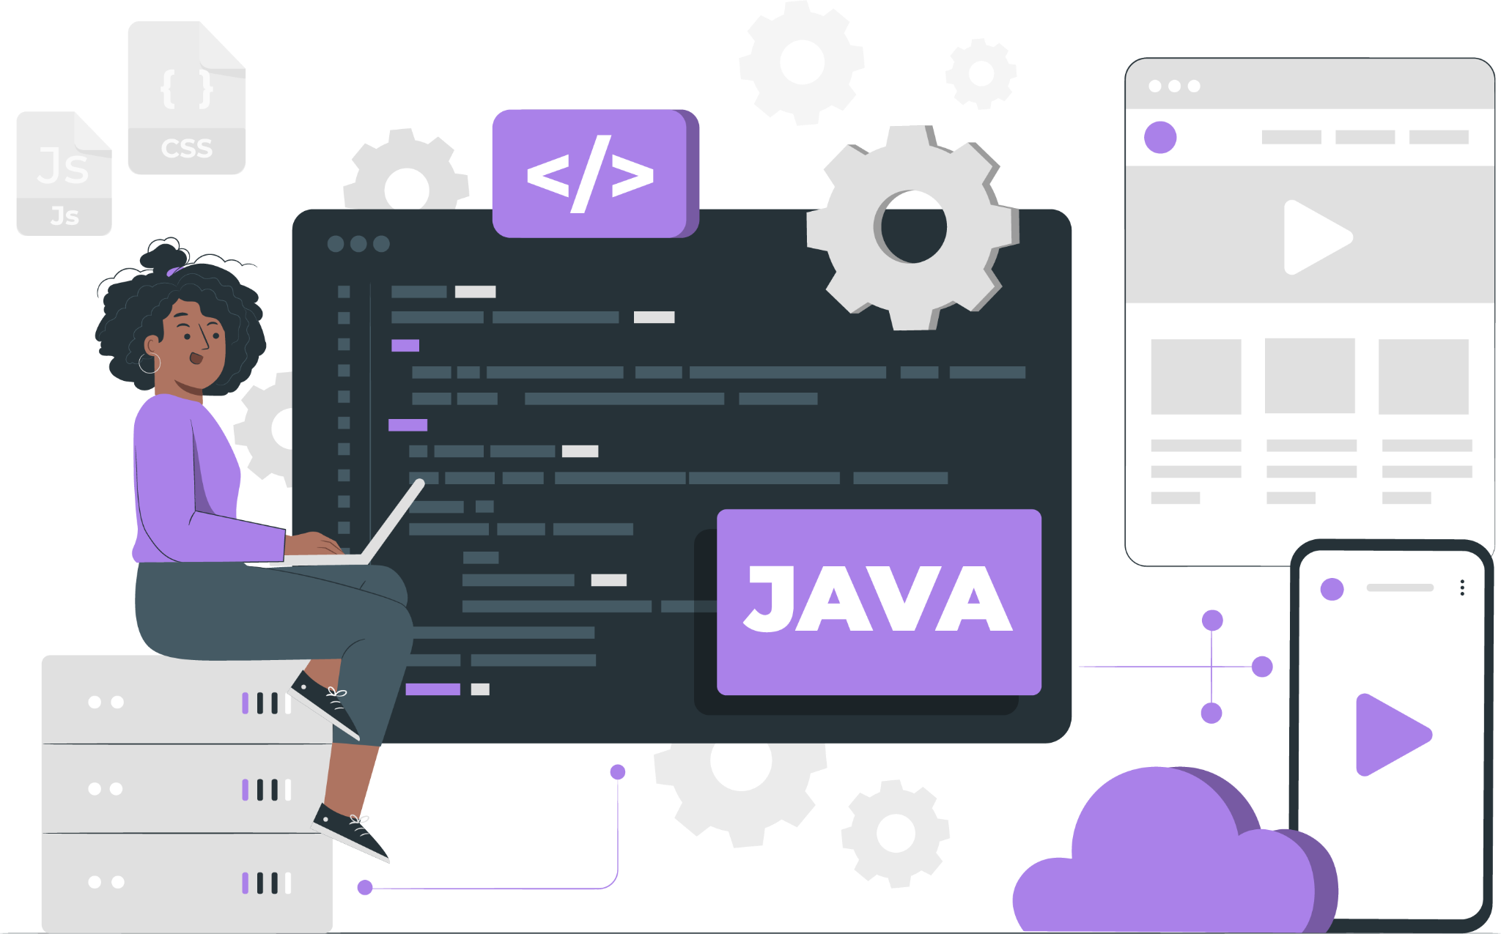
Lecture - 12
Arrays in Java

Slide 2
List of Concepts Involved:
Different ways to create an Array
ArrayIndexOutOfBoundsException
Disadvantages of Array in Java

Slide 3
Topics covered Yesterday's Session:
Introduction of Arrays

Slide 4
length vs length()
length: It is a property of the Array type class.
length(): It is a method of String class.

Slide 5
Anonymous Array
An array without a name is called Anonymous Array.
This type of array is created just for instance use.

Slide 6
ArrayIndexOutOfBoundsException
In java when we create an array, array index starts from 0 index.
Example:
int[] a = {10,20,30,40};
In the zero index we have 10, similarly in the first index we have 20, third index we have 30 and in fourth index we have 40.
If we try to access the index which is not in the array range then it would result in an Exception called “ArrayIndexOutOfBoundsException”.

Slide 7
Disadvantages of Arrays
once we create the size cannot be increased/decreased.
It stores only homogeneous data elements.

Slide 8
Next Lecture
String in Java

Slide 9
THANK YOU

